Slide 1

Edy haryanto S.kom, M.Eng

Slide 2




Edy haryanto S.kom, M.Eng
Fb.com/edy.pinkboy
@ edypinkboy
087838974423
Jalan Peternakan no 3 Selagalas Mataram

Slide 3
TK TK pertiwi
SD SDN Prayitnya
SPM SMPN 1 Praya
SMA SMAN 1 Praya
S1 Teknik Informatika
Univ. Amikom Yogyakarta
S2 Magister Teknologi Informasi
Uiversitas Gajah Mada
Awarde ELTA Australia Award 2022

Slide 4

Hoby Berpetualang di Alam
Cisco Confidential
© 2008 Cisco Systems, Inc. All rights reserved.
Presentation_ID

Slide 5

Cisco Confidential
© 2008 Cisco Systems, Inc. All rights reserved.
Presentation_ID

Slide 6

Cisco Confidential
© 2008 Cisco Systems, Inc. All rights reserved.
Presentation_ID

Slide 7

Cisco Confidential
© 2008 Cisco Systems, Inc. All rights reserved.
Presentation_ID

Slide 8
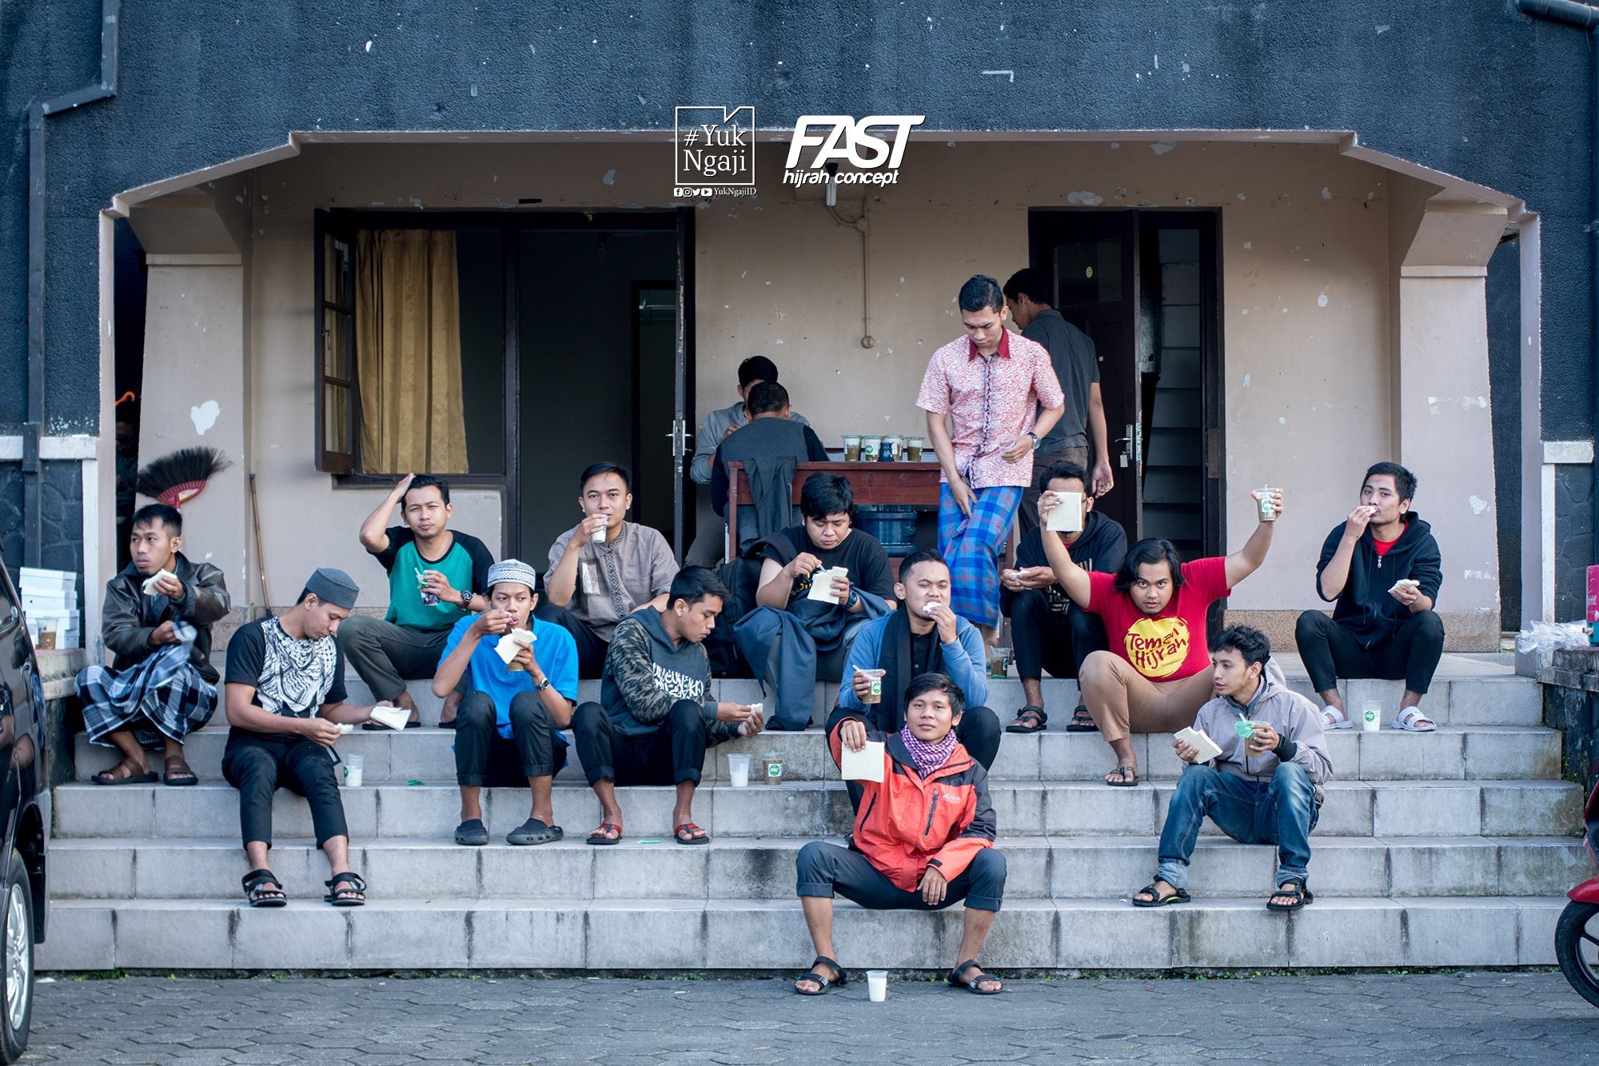
Komunitas YukNgaji
Cisco Confidential
© 2008 Cisco Systems, Inc. All rights reserved.
Presentation_ID

Slide 9
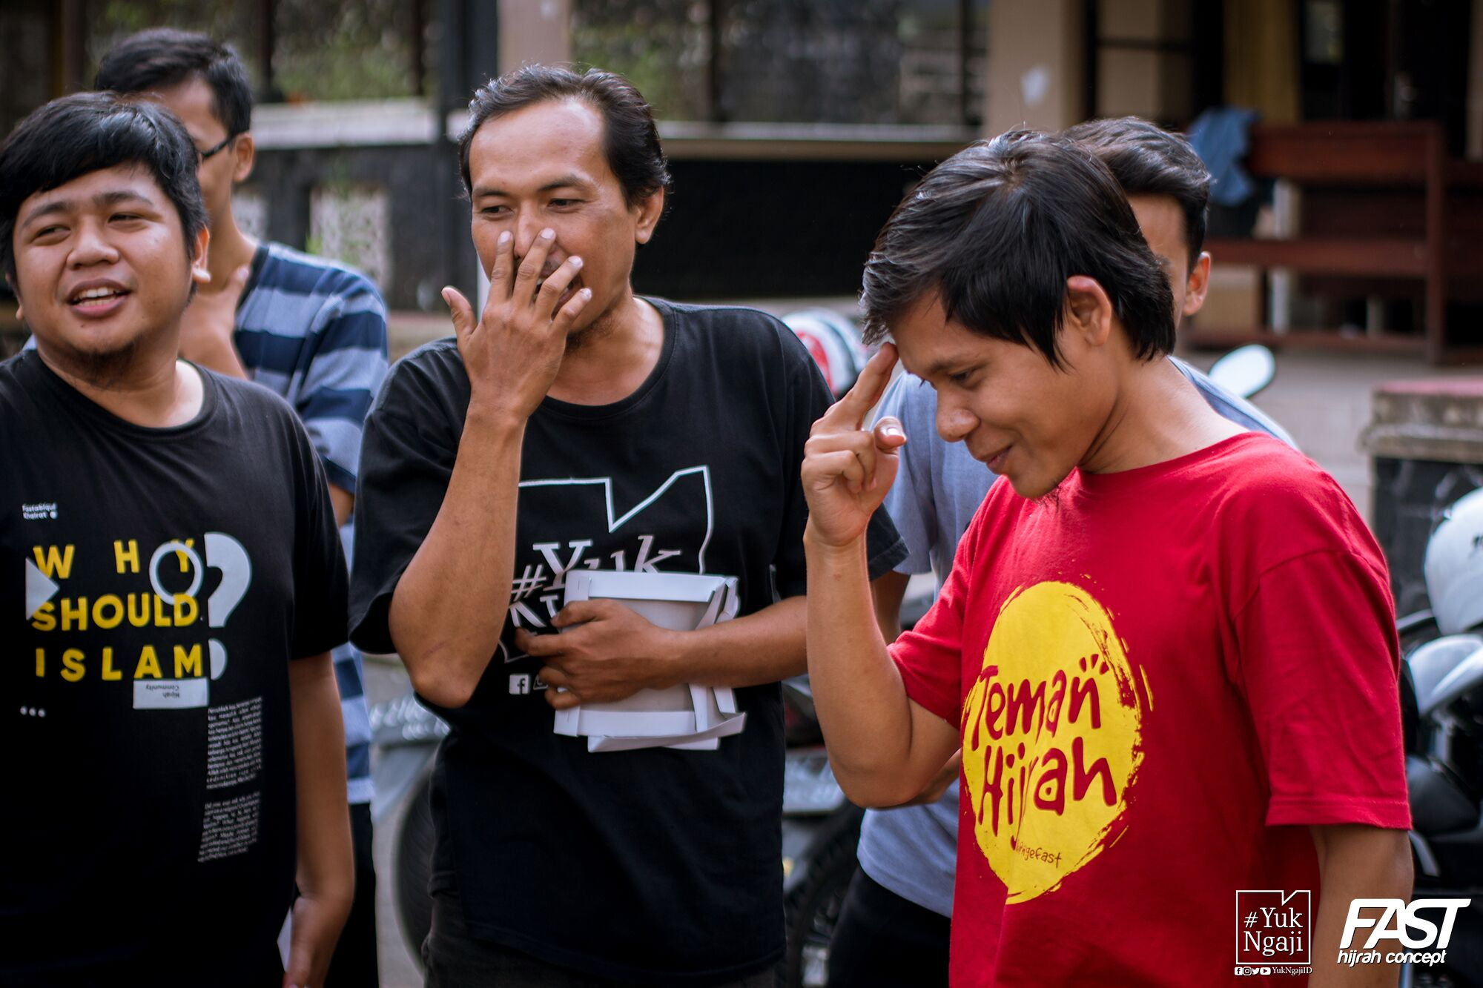
Komunitas YukNgaji
Cisco Confidential
© 2008 Cisco Systems, Inc. All rights reserved.
Presentation_ID

Slide 10
Cisco Confidential
© 2008 Cisco Systems, Inc. All rights reserved.
Presentation_ID

